Slide 1
The Work and Energy Principle for a Particle
Dr. Jacob Moore
Associate Professor of Engineering
Penn State Mont Alto

Slide 2
Work and Energy Method
The work energy method is best summarized as this...
“The work done to a system will be equal to the change in the system’s energy”
Work is...
A force applied over a distance
Energy is...
Kinetic Energy
Gravitational or Elastic Potential Energy

Slide 3
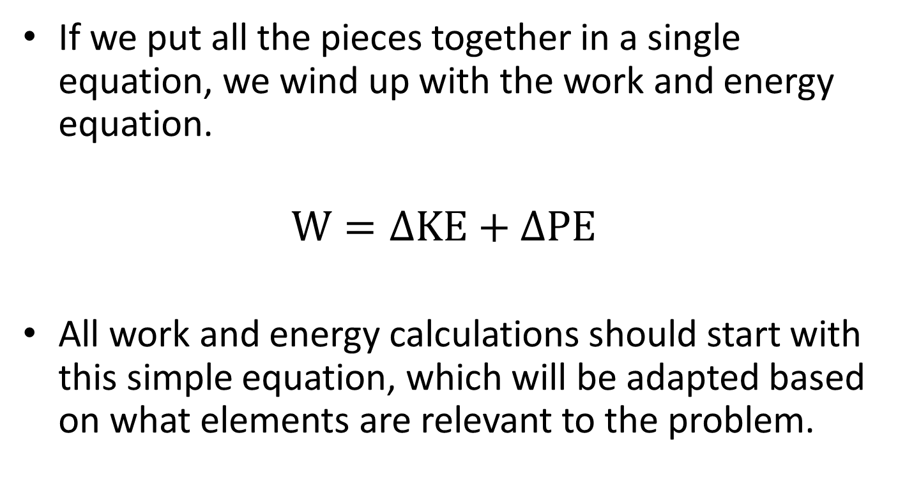
Work and Energy Method
If we put all the pieces together in a single equation, we wind up with the work and energy equation.
$$W=∆KE+∆PE$$
All work and energy calculations should start with this simple equation, which will be adapted based on what elements are relevant to the problem.

Slide 4
Work and Energy Method
The work and energy methods provide an alternative to the force, mass acceleration method.
Almost all kinetics problems can be solved either way.
The force mass acceleration method will be easier in some cases.
The work energy method will be easier in some other cases.
(The impulse momentum method will be easier in some third set of cases).

Slide 5
When to use the Work and Energy Method
The big question then is how will I know which kinetics method to use, and there is no absolute answer to this.
Work and energy works well when…
There are known velocities, or we are looking for velocities.
When we have problems involving springs
When objects are following a curved or complex path.
When we are only looking to solve for one or two unknowns
Work and energy does not work well when…
We need to examine accelerations
We need to know the directions of forces or velocities
We have a lot of unknowns to solve for

Slide 6
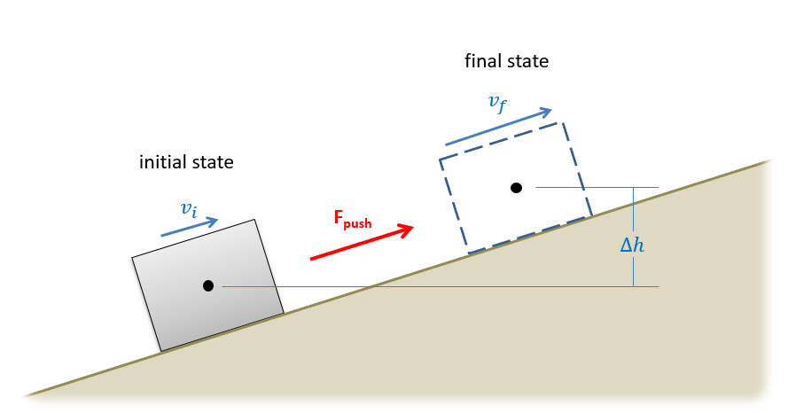
Setting up the Work and Energy Equation
To begin a work and energy problem, we will need start by defining an initial and final state.
If possible, draw these out and label relevant information at each step.
This isn’t the same as a free body diagram, but similar idea

Slide 7
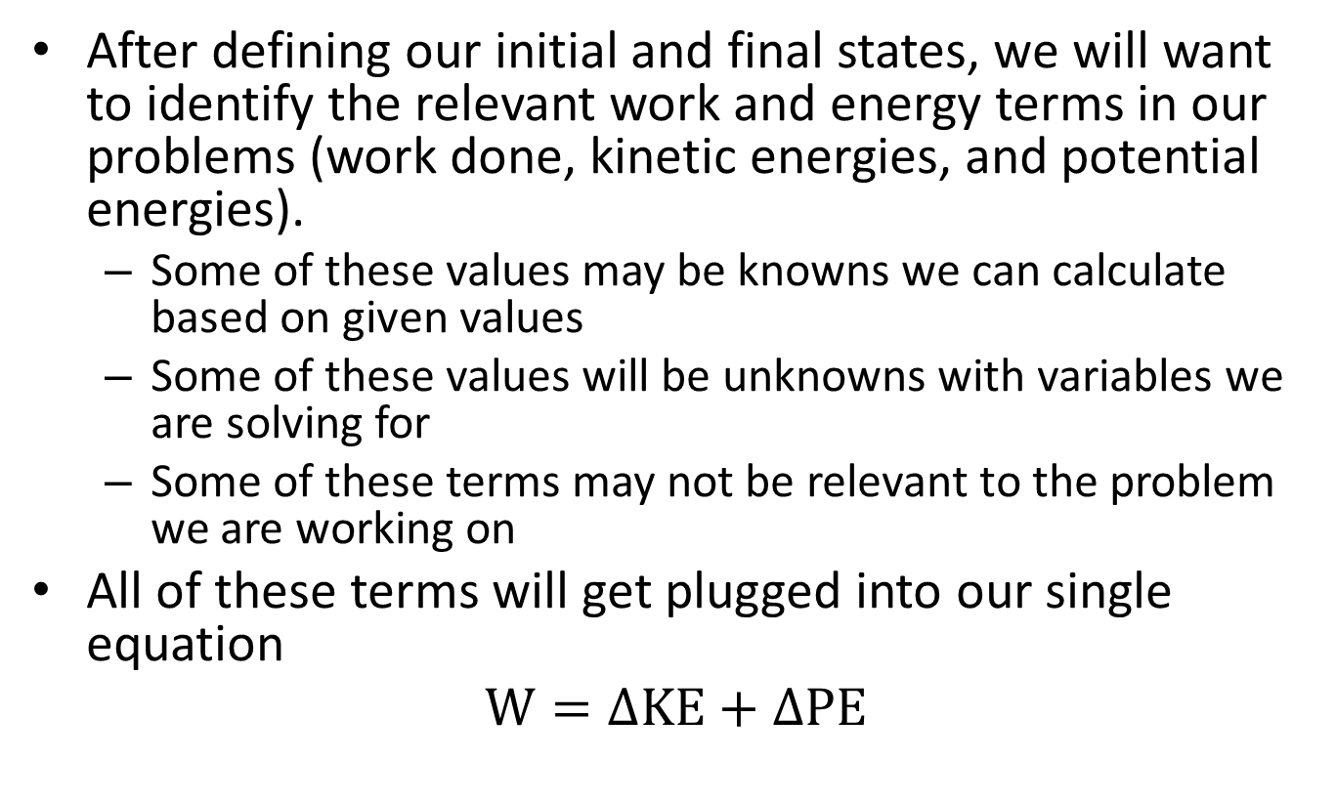
Setting Up the Work and Energy Equation
After defining our initial and final states, we will want to identify the relevant work and energy terms in our problems (work done, kinetic energies, and potential energies).
Some of these values may be knowns we can calculate based on given values
Some of these values will be unknowns with variables we are solving for
Some of these terms may not be relevant to the problem we are working on
All of these terms will get plugged into our single equation
$$W=∆KE+∆PE$$

Slide 8
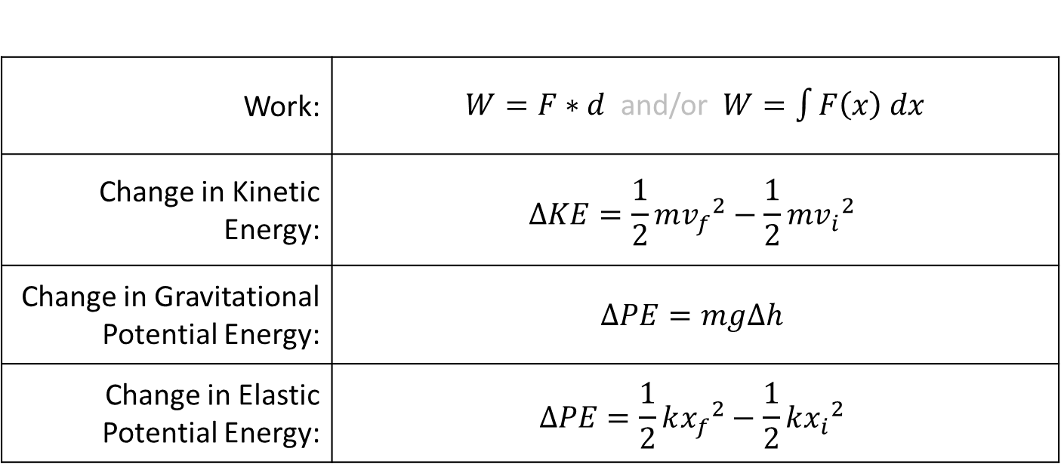
Work and Energy Terms
For particle systems, we have the following basic definitions…
Work: | $W=F∗d$ and/or $W=\int{F\left(x\right) dx}$
Change in Kinetic Energy: | $$∆KE=\frac{1}{2}m{v_{f}}^{2}−\frac{1}{2}m{v_{i}}^{2}$$
Change in Gravitational Potential Energy: | $$∆PE=mg∆h$$
Change in Elastic Potential Energy: | $$∆PE=\frac{1}{2}k{x_{f}}^{2}−\frac{1}{2}k{x_{i}}^{2}$$
Be careful not to double count gravity or spring forces. If gravitational potential energy and/or elastic potential energy is included in the equations, we should not include the work done by those forces

Slide 9
Work and Energy Methods and Kinematics
One of the primary limitations of the work and energy method, is that it only results in a single equation.
Because we only have a single equation to work with, we can only solve for a single unknown.
For this reason, we will often need to supplement the one equation with other kinematic relationships.
Relate velocities to positions or accelerations
Relate positions and displacements for potential energies

Slide 10
Solving the Work and Energy Equation
The last step in the process will be to solve the equation for the unknown value.
Or equations and values, if you have kinematic relationships as well.
With only a single equation it should not be too difficult, however the single equation can often get quite large, so simplifying the equation in steps may be useful.
Do pay attention to signs, generally some energies increase while others decrease.

Slide 11
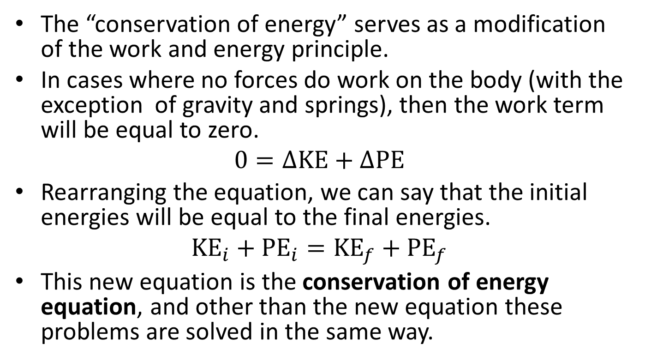
The Conservation of Energy
The “conservation of energy” serves as a modification of the work and energy principle.
In cases where no forces do work on the body (with the exception of gravity and springs), then the work term will be equal to zero.
$$0=∆KE+∆PE$$
Rearranging the equation, we can say that the initial energies will be equal to the final energies.
$${KE}_{i}+{PE}_{i}={KE}_{f}+{PE}_{f}$$
This new equation is the conservation of energy equation, and other than the new equation these problems are solved in the same way.

Slide 12
Thanks for Watching
See other engineering mechanics videos and access the full tool at…

Slide 13



final state
$$v_{f}$$
initial state
$$v_{i}$$
F_{push}
$$∆h$$

Slide 14
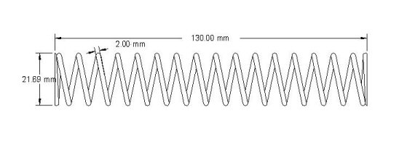
Work and Energy Worked Example
A spring with an unstretched length of 40 cm and a k value of 120 n/cm is used to lift a 5-kilogram box from a height of 20 cm to a height of 30 cm. If the box starts at rest, what would you expect the final velocity to be?
5 kg
5 kg
30 cm

Slide 15
Work and Energy Practice Problem
A 2000 lb wrecking ball hangs from the end of a 40 ft cable. If the wrecking ball is released from an angle of 40 degrees, what would we expect the maximum velocity at the bottom point to be?
40º

Slide 16
Work and Energy Worked Example
A 24,000 kg aircraft is launched from an aircraft carrier using the a hydraulic catapult. If the force the catapult exerts over the 90m runway is shown below...
What is the work done by the catapult?
What is the speed of the plane at the end of the runway?
$$F=1240 kN$$
$$F=205 kN$$
x
$$x=90m$$

